Slide 1
DRIVING IMPROVEMENT THROUGH NATIONAL GUIDANCE, NATIONAL & LOCAL AUDIT
Cameron Swift, King’s College School of Medicine, London

Slide 2
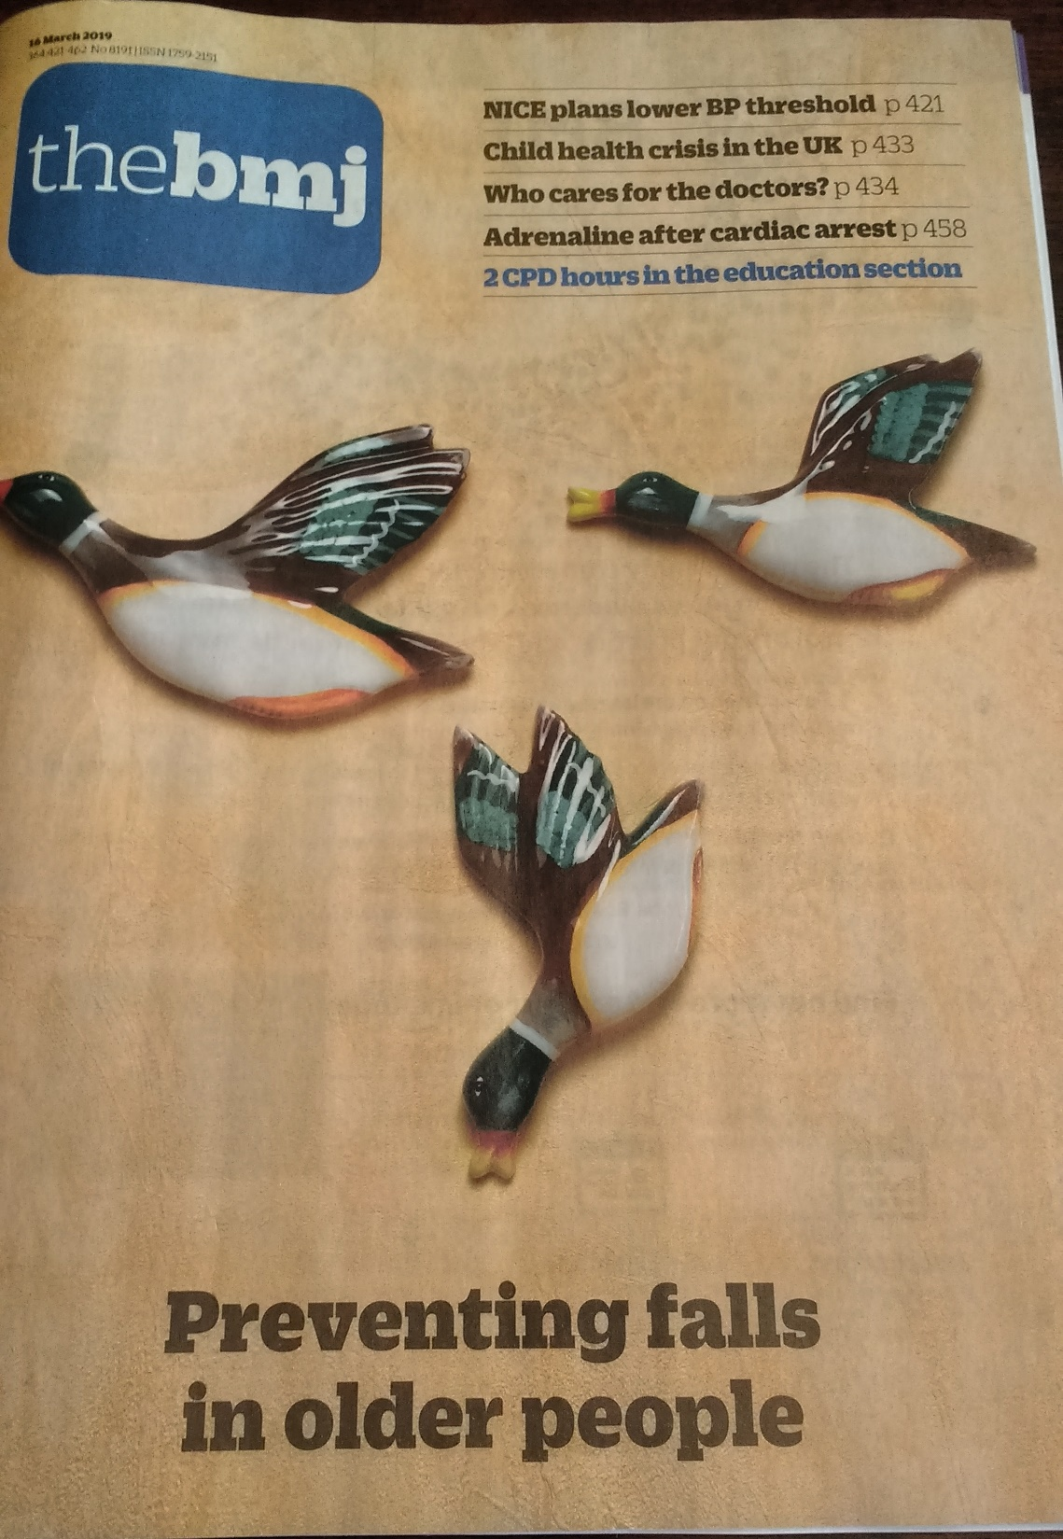

Slide 3
KEYS TO AN EFFECTIVE FALLS SERVICE
Concept – an age associated syndrome
Evidence - positive and negative
Structure - crossing all boundaries
Audit - measuring process and outcome

Slide 4
(1) CONCEPT: FALLS IN LATER LIFE – THE THREAT
30% >65: 50%>80 fall at least once yearly
Injury, disability, dependency, mortality
NHS annual cost >£2.3bn

Slide 5
(1) CONCEPT: FALLS IN LATER LIFE: THE SIGNAL
Commonly detectable (Intrinsic / Extrinsic):
Ageing processes (diminished physiological reserve)
Suboptimal physical fitness
Stable specific impairment (e.g. sensory, motor, visual, CNS)
Unstable systemic illness (diagnosed or undiagnosed)
Environmental risk factors

Slide 6
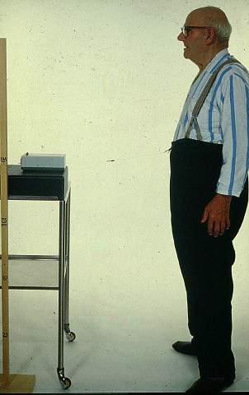

Slide 7
(2) EVIDENCE - POSITIVE: FALLS IN LATER LIFE – PREVENTABLE (Close et al, Lancet 1999)

Slide 8
(2) EVIDENCE - POSITIVE :- EXAMPLES OF ATTRIBUTABLE HEALTH PROBLEMS IDENTIFIED - (80% +) (Close et al, Lancet 1999)
Cardiovascular/circulatory – (e.g. postural hypotension , arrhythmias, carotid sinus syndrome, pacemaker failure) (17%)
Visual impairment (59%), poor stereoscopic vision (62%), cataract (35%)
Decreased lower limb power (28%)
Peripheral neuropathy (20%)
Measured strength/balance impairment (72%)
Measured cognitive impairment (34%), depression (18%)
Undiagnosed malignancy (2%)

Slide 9
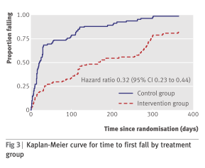
(2) EVIDENCE - POSITIVE: FALLS IN LATER LIFE – PREVENTABLE (LOGAN et al, BMJ 2010)
(7.68 vs 3.46 control vs intervention)

Slide 10
(2) EVIDENCE: FALLS IN INPATIENTS
Highest risk category
Heterogeneous studies and settings (e.g. acute. non-acute, mixed)
Inconsistent or negative findings with single factor or non-tailored interventions
Risk factor prediction tools insufficiently sensitive or specific
More research needed
Some moderate/low evidence for multifactorial assessment and intervention strategies

Slide 11
(2) EVIDENCE - POSITIVE: Effect of targeted risk factor reduction programme on inpatient falls (per thousand occupied bed days) (Healey et al, 2004)

Slide 12
(2) EVIDENCE:“NEGATIVE” , UNCERTAIN OR ATTENUATED INTERVENTION FINDINGS
Single interventions – untargeted group exercise, cognitive/behavioural, vision correction alone, Vit D (?)
Focus on cognitive impairment (A&E /Care home) (e.g. Shaw et al, 2003, Whitney et al, 2017)
Unidisciplinary assessment with non-linked referral (Lightbody et al, 2002; Spice et al 2009)
Risk factor prediction tools in inpatients [e.g. Barker et all (6-Pack), 2015)
Assistive technology

Slide 13
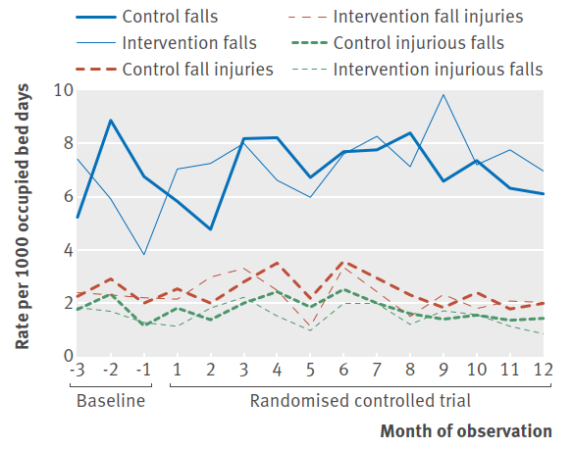
(2) The “6-pack” (risk prediction tool based) study [Barker et al; bmj (2016) 352;h6781]

Slide 14
(2) Evidence – based national guidance - NICE guideline on falls (CG161)
Case/risk identification
Multifactorial falls risk assessment/diagnosis
Falls history
Assessment of:
gait, balance and mobility, and muscle weakness
osteoporosis risk
perceived functional ability and fear relating to falling
visual impairment
cognitive impairment and neurological examination
urinary continence
environmental hazards
Cardiovascular examination and medication review
Individualised multifactorial interventions

Slide 15
(2) EVIDENCE - Exercise in older people living in the community (Cochrane Review 2019) (Sherrington et al)
108 RCTs with 23,407 participants living in the community in 25 countries.
Most trials had unclear or high risk of bias
81 trials (19,684 participants) compared exercise (all types) with control
Exercise reduces the rate of falls by 23% and number of people experiencing one or more falls by 15%
Findings for other outcomes are less certain

Slide 16
(3) IMPLEMENTATION: CG 161 GENERIC FALLS ASSESSMENT AND INTERVENTION ACTIVITY (UK evidence & focus)
CASE/RISK
IDENTIFICATION
NETWORKED
FALLS SERVICE
Case / risk identified at health screen
MULTI-FACTORIAL
ASSESS-MENT
INDIVIDUAL-ISED SINGLE OR MULTI-FACTORIAL INTERVEN-TION & FOLLOW-UP
PRIMARY & COMMUNITY
CARE
Case / risk identified at presentation with fall / other problem
Case / risk identified at presentation with fall / other problem
SECONDARY
CARE
Presentation at A&E with fall injury/ Inpatient >65 / or Inpatient >50 with known clinical risk
BONE HEALTH
SERVICE

Slide 17
(3) IMPLEMENTATION - COORDINATING ACROSS BOUNDARIES: GENERIC FALLS SERVICE NETWORK – AN OPPORTUNITY TO LEAD
PRIMARY & COMMUNITY
CARE
MAINSTREAM SECONDARY CARE
NETWORKED FALLS SERVICE (LINKED TO MEDICAL GERONTOLOGY)
ACCIDENT & EMERGENCY MEDICINE
POPULA
TION-BASED/
OPPORTUN-ISTIC SCREENING
ACUTE INPATIENT MEDICAL GERONTOLOGY
TRAUMA, & ORTHO-PAEDICS
OTHER MEDICAL & SURGICAL SPECIALITIES
HOME-BASED EXERCISE
PROGRAMMES
DAY HOSPITAL, OUTPATIENT CLINICS & REHABILITATION
BONE HEALTH SERVICE

Slide 18
(4) NATIONAL AUDIT - QS 86 2017 UPDATE STATEMENTS
1 Older people are asked about falls when they have routine assessments and reviews with health and social care practitioners, and if they present at hospital.
2. Older people at risk of falling are offered a multifactorial falls risk assessment.
3. Older people assessed as being at increased risk of falling have an individualised multifactorial intervention.
4.Older people who fall during a hospital stay are checked for signs or symptoms of fracture and potential for spinal injury before they are moved.
5. Older people who fall during a hospital stay and have signs or symptoms of fracture or potential for spinal injury are moved using safe manual handling methods.
6. Older people who fall during a hospital stay have a medical examination.
7. Older people who present for medical attention because of a fall have a multifactorial falls risk assessment.
8. Older people living in the community who have a known history of recurrent falls are referred for strength and balance training.
9. Older people who are admitted to hospital after having a fall are offered a home hazard assessment and safety interventions.

Slide 19
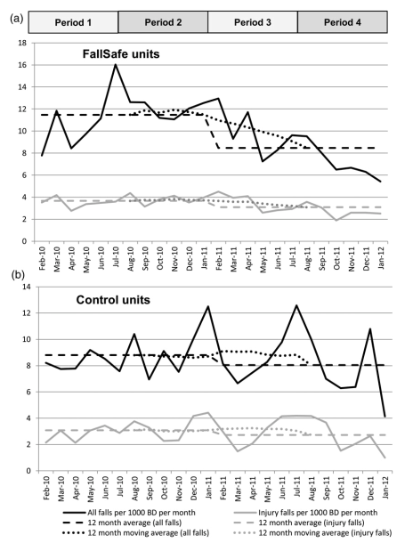
(4) AUDIT - INPATIENT IMPLEMENTATION & OUTCOME MEASUREMENT “Fallsafe” QI evaluation [Healey et al 2014]

Slide 20
(4) AUDIT - “Fallsafe” care bundle key elements [RCP 2015]
Cognitive assessment
Delirium screen
Bed-rail/Ultra-low bed strategy
Basic visual check
Lying & standing blood pressure & pulse
Medical & medication review
Tailored on-ward (v 2-hr) observation regimen

Slide 21
(4) NATIONAL AUDIT – SNAPSHOT DATA -INPATIENT FALLS 2017 (v 2015) (RCP 2019)

Slide 22
(4) AUDIT - IMPROVING IMPLEMENTATION (RCP NAIF 2017)
MANAGEMENT LEVEL
Organisation-wide Patient Safety Group
Structured rapid assessment procedures (including standardised delirium tools)
Robust data and reporting on falls & fractures
CLINICAL
Multi-D Falls Working Group auditing v QS 86
Audit of Postural BP, Visual, Medication and Walking-aid use review and provision

Slide 23
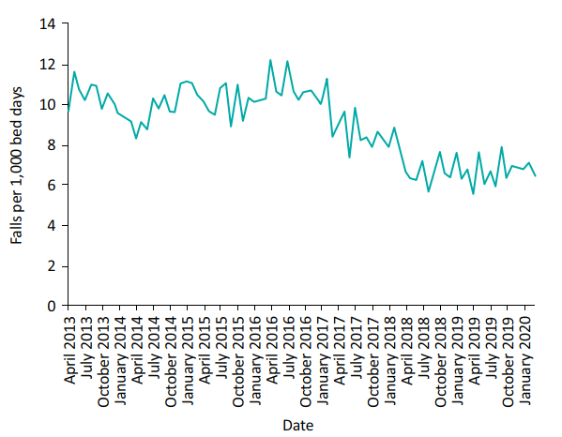
4: ON-SITE AUDIT/QI: Inpatient falls per 1,000 bed days AT Northumbria Healthcare NHS Foundation Trust 2013–2020. (Richardson et al., 2020)

Slide 24
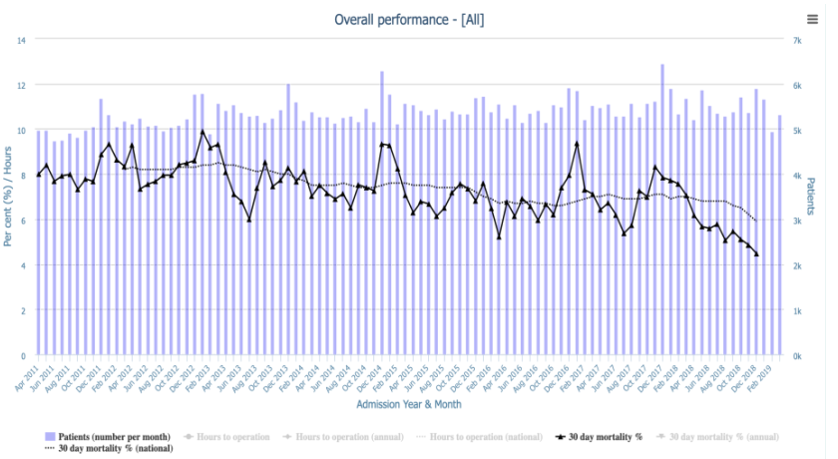
(4) Continuous Audit: HIP FRACTURE 30-day mortality, 2011-2018 (NHFD 2019)

Slide 25
(4) NATIONAL AUDIT OF INPATIENT FALLS (naif) 2018-21 (RCP 2020)
Focus on inpatient hip fracture (IHF).
Rational sensitive audit outcome measure
Continuous year-round national data collection (NHFD)
Increased incentive for trust level participation
Fall prevention management audited for IHF only
All inpatient settings eligible to participate (inc. community, specialist, mental health trusts)
Data collection to include immediate post fall management (QS 86)
Data entered onto the NHFD as IHF
Once yearly facilities audit

Slide 26
(4) Nhfd Data 2018 (naif audit) (RCP 2020)

Slide 27
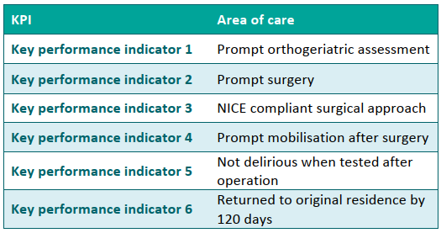
(4) NHFD KPI’s [NHFD 2018]

Slide 28
(4) Naif FACILITIES AUDIT Participation 2019 (RCP 2020)

Slide 29
(4) PROCEDURE USE NEEDING FURTHER EVIDENCE (naif Facilities audit 2019) (RCP 2020)

Slide 30
(4) VARIANCE FROM falls prevention GUIDANCE RECOMMENDATIONS (naif Facilities audit 2019) (RCP 2020)

Slide 31
(4) Implementation management (naif Facilities audit 2019) (RCP 2020)

Slide 32
(4) NICE QS 86 ADHERENCE (naif audit) (RCP 2020)

Slide 33
NICE CG 161: COST-EFFECTIVENESS OF INPATIENT FALLS PREVENTION

Slide 34
(4) AUDIT - [CLINICAL AND OPERATIONAL] (DAVISON et al, 2005)

Slide 35
Progress? – challenge & opportunity
Crucial to maintain broad age concept, cross-boundary and community awareness
More robust research evidence still needed
Inpatient fracture a valuable audit focus for inpatient falls prevention
NAIF (linked to NHFD) operationally promising – high levels of participation and completion
NAIF a driver for improvement in organisational, operational and clinical practice standards

Slide 36
If you have been, thank you for listening!

